Slide 1
Neurocognitive Symptoms in PASC
Presented By:
Andrew Schamess, MD
July 10, 2023

Slide 2
Learning Objectives
Understand working criteria for the diagnosis of PASC.
Understand possible causes of neuroinflammation in PASC and relationship to cognitive symptoms.
Understand the impact of PASC on patients’ quality of life and functional status.
Understand behavioral, rehabilitative, pharmacologic and interventional therapies commonly used to manage neurocognitive symptoms in PASC.

Slide 3
Long COVID definitions
Centers for Disease Control
World Health Organization
CDC uses the term “post-COVID conditions” (PCC) as an umbrella term for the wide range of health consequences that can be present four or more weeks after infection with SARS-CoV-2, the virus that causes COVID-19.
Post COVID-19 condition occurs in individuals with a history of probable or confirmed SARSCoV-2 infection, usually 3 months from the onset of COVID-19 with symptoms that last for at least 2 months and cannot be explained by an alternative diagnosis.
National Institute for Health and Care Excellence
Acute COVID-19: Signs and symptoms of COVID‑19 for up to 4 weeks.
Ongoing symptomatic COVID-19: Signs and symptoms of COVID‑19 from 4 weeks up to 12 weeks.
Post-COVID-19 syndrome: Signs and symptoms that develop during or after an infection consistent with COVID‑19, continue for more than 12 weeks and are not explained by an alternative diagnosis.

Slide 4
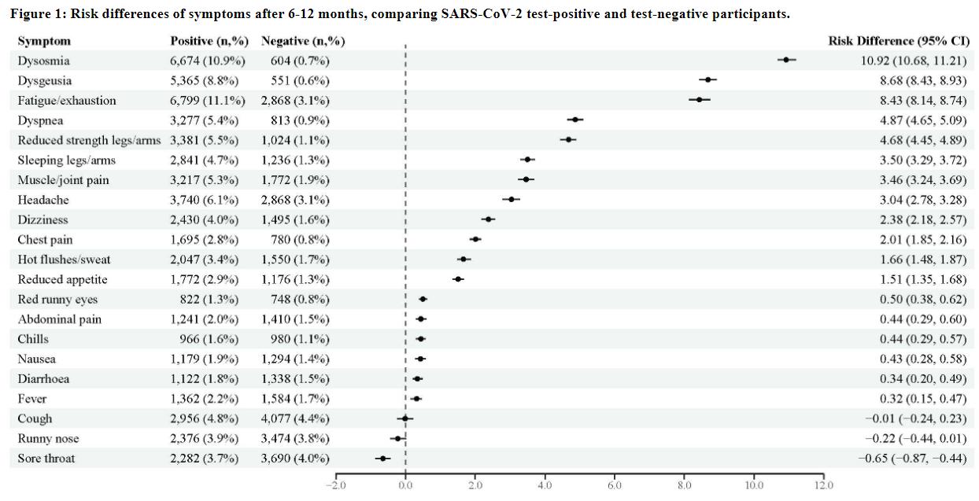
Risk for individual symptoms 6-12 months after positive versus negative test for SARS-CoV-2
Nationwide questionnaire (Denmark)
61,002 persons PCR positive for SARS-CoV-2 compared with 98,878 test-negative
Sørensen AIV, Spiliopoulos L, Bager P, et al. A nationwide questionnaire study of post-acute symptoms and health problems after SARS-CoV-2 infection in Denmark. Nat Commun. 2022;13(1):4213.

Slide 5
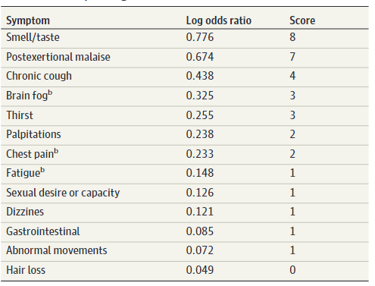
Development of a Definition of Post Acute Sequelae of COVID19 (RECOVER Initiative)
9764 adult participants at 33 sites.
8646 had SARS-CoV-2 infection; there were 1118 non-infected controls.
Self-reported symptoms assessed by a standardized questionnaire.
A rule for identifying PASC was derived by statistical analysis.
12 symptoms were identified with scores from 1-8
Using a cutoff of 12, 23% of infected and 3.7% of uninfected participants were identified with PASC
Thaweethai T, Jolley SE, Karlson EW, et al. Development of a Definition of Postacute Sequelae of SARS-CoV-2 Infection. JAMA. 2023;329(22):1934-1946.

Slide 6
Common Neuropsychological Symptoms in PASC
Cognitive (“brain fog”) | Trouble concentrating, forgetfulness, word-finding difficulty, semantic dysfluency, cognitive fatigability
Fatigue | Task-related, continuous, intermittent, diurnal, post-exertional malaise (PEM)
Paresthesia | Myalgia (generalized, localized, migratory), tingling, numbness
Dysautonomia | Heart rate, respiration, dysphonia, dysphagia, post-prandial fullness, diarrhea, sexual dysfunction, “hot flashes”
Headache | Chronic daily headache, migraine
Mood symptoms | Anxiety, depression – primary versus reactive (adjustment disorder)
Sleep disturbance | Trouble falling asleep, frequent or early awakening
Disturbances of smell and taste | Absence, reduction, distortion

Slide 7
Cognitive Performance – Post-Covid Condition Versus Healthy Controls
319 post-COVID subjects and 109 healthy controls (18-65 years old) underwent a comprehensive neuropsychological battery for cognitive assessment.
Ariza M, Cano N, Segura B, et al. Neuropsychological impairment in post-COVID condition individuals with and without cognitive complaints. Front Aging Neurosci. 2022;14:1029842.

Slide 8
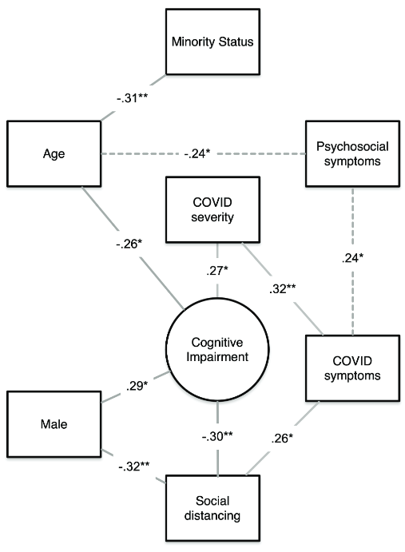
Cognitive test outcomes after mild COVID-19
Neuropsychological testing conducted on 79 subjects, aged 22-65 years, mean of 3.8 months post-diagnosis .
Subjective cognitive impairment: 15%
Objective cognitive impairment: 40%
Executive functioning deficit: 28%
Impaired attention and processing speed: 17%
Impaired delayed recall: 15%
Reduced cognitive flexibility: 13%
Impaired immediate recall: 11%
COVID-19 symptoms/severity were not associated with overall objective cognitive function
Henneghan AM, Lewis KA, Gill E, Kesler SR. Cognitive Impairment in Non-critical, Mild-to-Moderate COVID-19 Survivors. Front Psychol. 2022;13:770459.

Slide 9
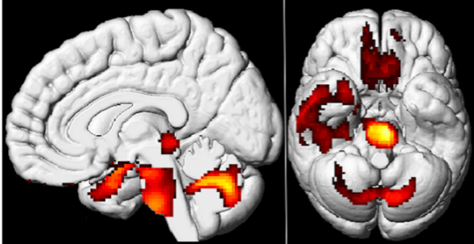
PET hypometabolism in patients with Long COVID compared with COVID negative controls
PET scans of 35 Long COVID patients were compared by whole-brain voxel analysis with 40 matched COVID negative controls
Long COVID patients showed hypometabolism in the brainstem (p=0.004) and cerebellum (p- 0.001)
Areas affected included the olfactory gyrus, amygdala and the hippocampus, the bilateral pons/medulla and cerebellum
Guedj E, Campion JY, Dudouet P, et al. 18F-FDG brain PET hypometabolism in patients with long COVID. Eur J Nucl Med Mol Imaging. 2021;48(9):2823-2833.

Slide 10
PET hypometabolism in patients with Long COVID compared with COVID negative controls
Complaints of anosmia, memory and cognitive impairment, pain and insomnia correlated with hypometabolism in brain areas associated with those functions.
Guedj E, Campion JY, Dudouet P, et al. 18F-FDG brain PET hypometabolism in patients with long COVID. Eur J Nucl Med Mol Imaging. 2021;48(9):2823-2833.

Slide 11
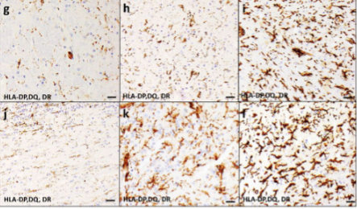
Autopsy findings in 20 patients who died of acute COVID19
Moderate to severe microglial inflammation was seen in 80%.
Other findings included recent hemorrhage, acute vascular injury, hypoxic injury, and chronic age-related pathologies.
Stain shows microglial activation in the medulla and olfactory bulb
Agrawal S, Farfel JM, Arfanakis K, et al. Brain autopsies of critically ill COVID-19 patients demonstrate heterogeneous profile of acute vascular injury, inflammation and age-linked chronic brain diseases. Acta Neuropathologica Communications. 2022;10(1):186.

Slide 12
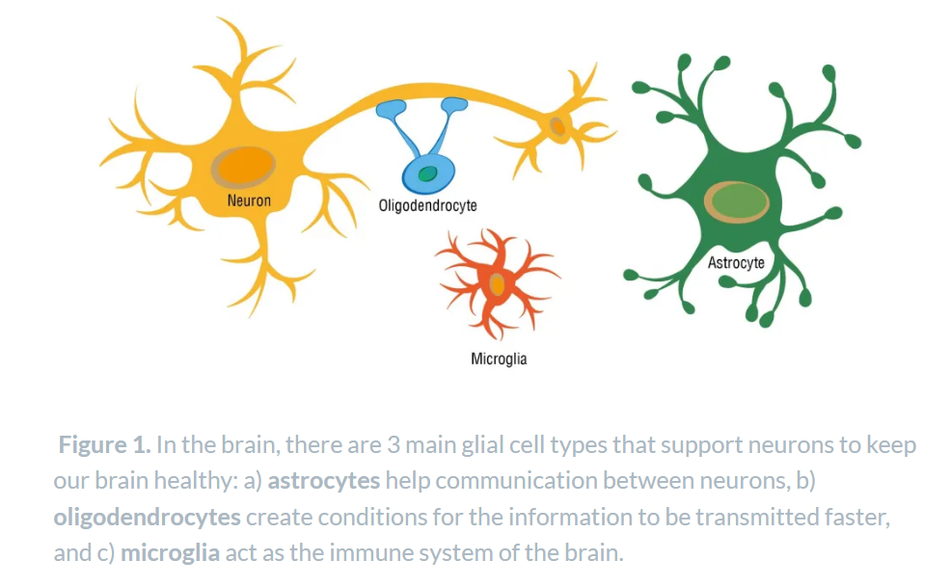
Ozturk M. Microglia: The Protectors of the Brain. Harvard Science in the News. Published January 18, 2022. https://sitn.hms.harvard.edu/flash/2022/microglia-the-protectors-of-the-brain/ Accessed July 9, 2023.

Slide 13
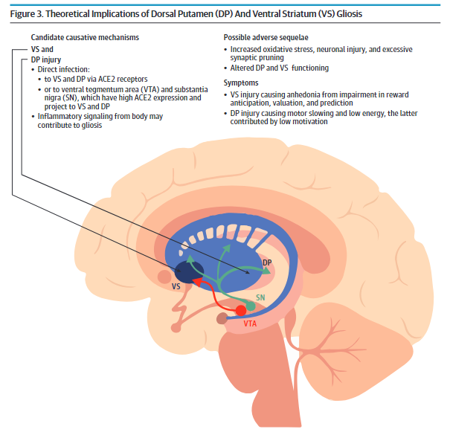
PET indicators of gliosis in Long COVID patients
40 adult patients with depressive symptoms +/- cognitive symptoms after mild to moderate SARS-CoV-2 infection, and 40 matched controls.
PET imaging of translocator protein used to identify areas of gliosis.
Glial activation in ventral striatum and dorsal putamen was most elevated compared with controls.
Putamen: motor control, learning (anticipation/reward), language.
Ventral striatum connects reward with motor behavior (lesion => anhedonia).
Braga J, Lepra M, Kish SJ, et al. Neuroinflammation After COVID-19 With Persistent Depressive and Cognitive Symptoms. JAMA Psychiatry. Published online May 31, 2023. doi:10.1001/jamapsychiatry.2023.1321

Slide 14
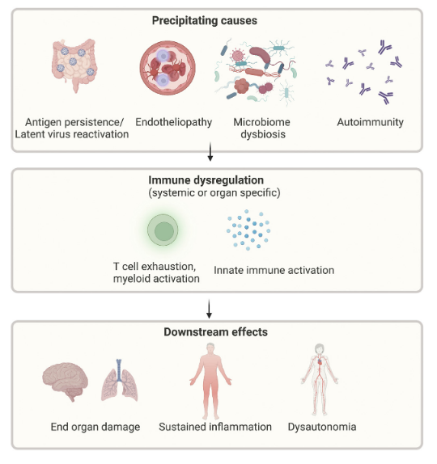
Proposed mechanisms of Long COVID
Kenny G, Townsend L, Savinelli S, Mallon PWG. Long COVID: Clinical characteristics, proposed pathogenesis and potential therapeutic targets. Front Mol Biosci. 2023;10:1157651.

Slide 15
Direct and indirect effects of SARS-CoV-2 virus on the brain and mode of entry into the CNS
Virus enters with T-cells due to increased BBB permeability
Virus binds to endothelial cell and penetrates the BBB directly
Virus attacks nasal mucosa and is transported retrograde through olfactory neurons
Virus stimulates production of IL2-beta, which binds to endothelial cells and allows cytokine and immune blood cell entry into CNS, leading to neuroinflammation and cell death
Granholm AC. Long-Term Effects of SARS-CoV-2 in the Brain: Clinical Consequences and Molecular Mechanisms. J Clin Med Res. 2023;12(9).

Slide 16
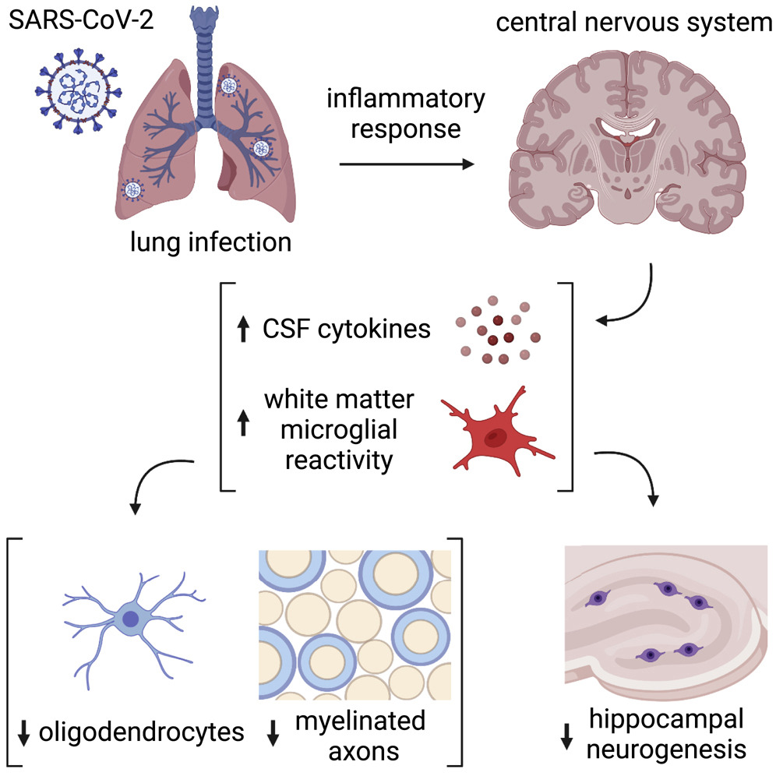
Brain fog: neuroinflammatory hypothesis
Airway infection leads to inflammatory response.
Cytokines, including CCL11, enter the CNS.
Microglia (CNS macrophages) are activated.
This leads to impairment of…
Impaired homeostasis and plasticity of myelin-forming cells.
Impaired hippocampal neurogenesis (necessary for healthy memory function).
Induction of neurotoxic astrocytes.
Fernández-Castañeda A, Lu P, Geraghty AC, et al. Mild respiratory COVID can cause multi-lineage neural cell and myelin dysregulation. Cell. 2022;185(14):2452-2468.e16.

Slide 17
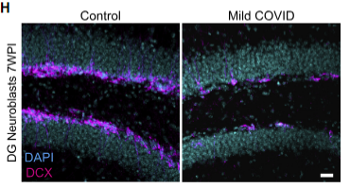
Brain fog: neuroinflammatory hypothesis
Micrographs of neuroblasts (nerve cell precursors) in the medial dentate gyrus of the hippocampus of mice 7 weeks after acute COVID19 infection versus control mice.
This was associated with elevated CCL-11 levels in the serum of the infected compared with control mice.
Fernández-Castañeda A, Lu P, Geraghty AC, et al. Mild respiratory COVID can cause multi-lineage neural cell and myelin dysregulation. Cell. 2022;185(14):2452-2468.e16.

Slide 18
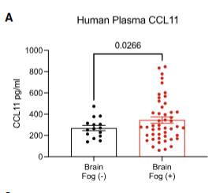
Brain fog: neuroinflammatory hypothesis
Serum levels of CCL-11 in human subjects with Long COVID and brain fog versus healthy controls
Fernández-Castañeda A, Lu P, Geraghty AC, et al. Mild respiratory COVID can cause multi-lineage neural cell and myelin dysregulation. Cell. 2022;185(14):2452-2468.e16.

Slide 19
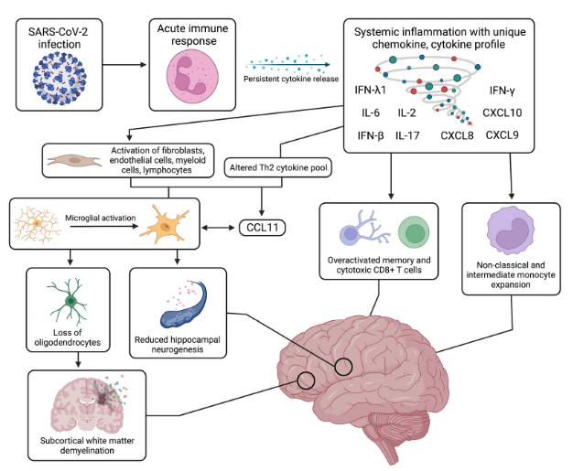
Systemic and Neurological Immune Response
Leng A, Shah M, Ahmad SA, et al. Pathogenesis Underlying Neurological Manifestations of Long COVID Syndrome and Potential Therapeutics. Cells. 2023;12(5). doi:10.3390/cells12050816

Slide 20
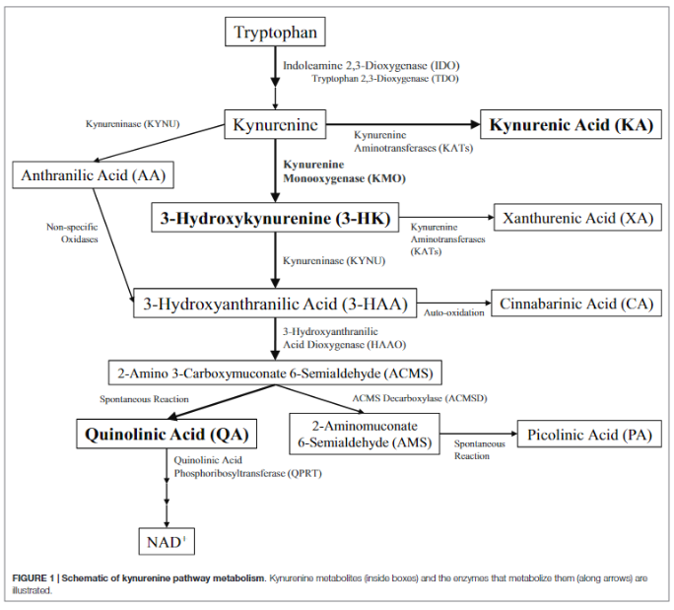
Normal tryptophan metabolism
Tryptophan is an essential amino acid – obtained from diet and from production by gut microbes.
Tryptophan and its metabolite, kynurenine, cross the blood-brain barrier.
In astrocytes, kynurenine is metabolized to kynurenic acid (KA), which is (generally) neuroprotective.
In microglia, kynurenine is metabolized to quinolinic acid (QA), which is neurotoxic at high doses.
Persistent brain inflammation leads to high QA level at synapses.
QA is an excitotoxin at the NMDA receptor.
Parrott JM, O’Connor JC. Kynurenine 3-Monooxygenase: An Influential Mediator of Neuropathology. Front Psychiatry. 2015;6:116.

Slide 21
The kynurenine to quinolinic acid pathway has been implicated in numerous neuropsychiatric diseases
Huntington’s Disease
Parkinson’s Disease
Alzheimer’s Disease
Depression
Schizophrenia
Traumatic Brain Injury
Multiple Sclerosis
Systemic Lupus with CNS symptoms
…PASC?

Slide 22
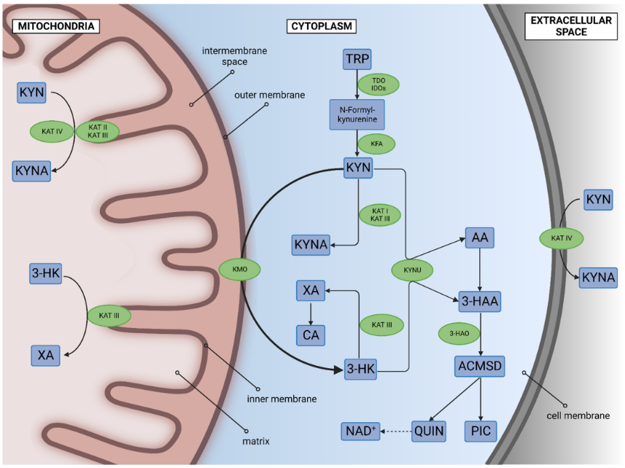
Location of enzymes active in tryptophan metabolism
Tanaka M, Szabó Á, Spekker E, Polyák H, Tóth F, Vécsei L. Mitochondrial Impairment: A Common Motif in Neuropsychiatric Presentation? The Link to the Tryptophan-Kynurenine Metabolic System. Cells. 2022;11(16). doi:10.3390/cells11162607

Slide 23
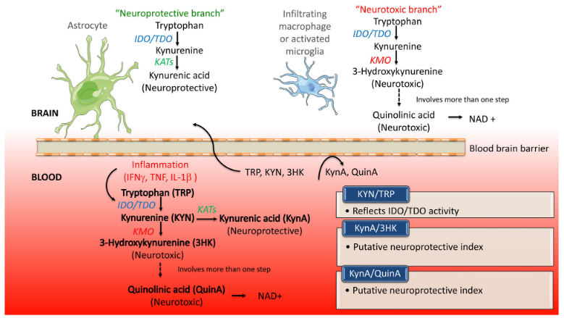
Two cell types, two pathways of tryptophan metabolism
Meier TB, Savitz J. The Kynurenine Pathway in Traumatic Brain Injury: Implications for Psychiatric Outcomes. Biol Psychiatry. 2022;91(5):449-458.

Slide 24
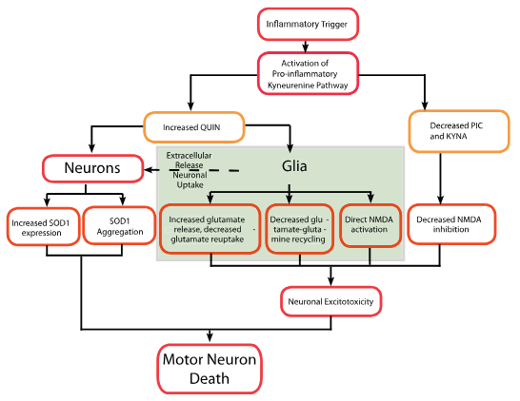
Mechanism of quinolinic acid neurotoxicity
Lovelace MD, Varney B, Sundaram G, et al. Recent evidence for an expanded role of the kynurenine pathway of tryptophan metabolism in neurological diseases. Neuropharmacology. 2017;112(Pt B):373-388.

Slide 25
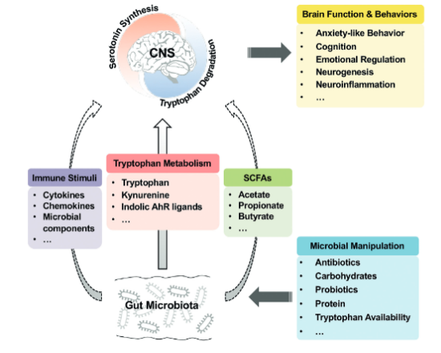
Manipulation of gut microbiota through diet, antibiotics, etc. contribute to shifts between serotonin synthesis and degradation via:
Changes in levels of serotonin precursors reaching the brain (tryptophan, kynurenine)
Immune signals
Short-chain fatty acids
There is evidence that SARS-CoV-2 infection selects for gut microbes that produce tryptophan and kynurenine
Gao K, Mu CL, Farzi A, Zhu WY. Tryptophan Metabolism: A Link Between the Gut Microbiota and Brain. Adv Nutr. 2020;11(3):709-723.

Slide 26
The kynurenine pathway and objective cognitive impairment in PASC
128 subjects with confirmed Sars-CoV-2 infection.
No PASC (fully recovered from acute infection): 45%
PASC (persistent symptoms at 2 months): 55%
without disability: 26%
with disability: 29%
Followed for 12 months with neurocognitive assessments, patient-reported measures of brain fog and functioning, and measurement of kynurenine metabolites.
Prevalence of objective cognitive deficits (by CogState neurocognitive battery) was 15-25% in the study subjects over the course of 12 months.
Cysique LA, Jakabek D, Bracken SG, et al. The kynurenine pathway relates to post-acute COVID-19 objective cognitive impairment and PASC. Ann Clin Transl Neurol. Published online June 15, 2023. doi:10.1002/acn3.51825

Slide 27
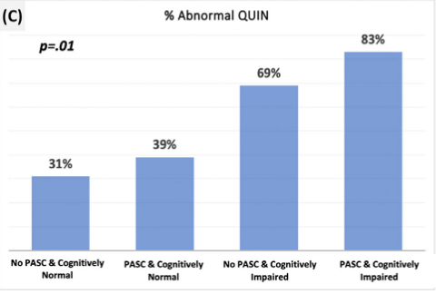
The kynurenine pathway and objective cognitive impairment in PASC
Levels of quinolinic acid were significantly correlated with objective cognitive impairment.
Cysique LA, Jakabek D, Bracken SG, et al. The kynurenine pathway relates to post-acute COVID-19 objective cognitive impairment and PASC. Ann Clin Transl Neurol. Published online June 15, 2023. doi:10.1002/acn3.51825

Slide 28
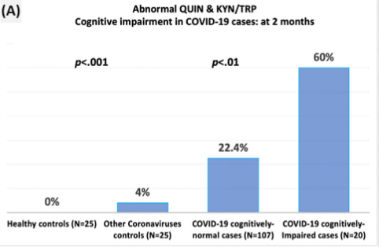
The kynurenine pathway and objective cognitive impairment in PASC
Abnormal quinolinic acid levels and kynurenine/tryptophan ratios were seen much more frequently in subjects with post-COVID cognitive impairment than in those without; and not at all in healthy controls.
Data at 2 months shown; data were similar for cognitive impairment at any study visit.
Cysique LA, Jakabek D, Bracken SG, et al. The kynurenine pathway relates to post-acute COVID-19 objective cognitive impairment and PASC. Ann Clin Transl Neurol. Published online June 15, 2023. doi:10.1002/acn3.51825

Slide 29
Relationship between PASC, subjective cognitive complaints, and measured cognitive deficits
Out of 20 subjects with objective cognitive deficits, 70% had PASC and 30% did not.
Subjective cognitive symptoms (“brain fog”) were reported by 24.5% of subjects with PASC and 54% of subjects with PASC and disability.
There was no association between self-reported cognitive symptoms and objective cognitive impairment.
PASC
Brain Fog
Objective Cognitive Deficits / High QA
No PASC
Cysique LA, Jakabek D, Bracken SG, et al. The kynurenine pathway relates to post-acute COVID-19 objective cognitive impairment and PASC. Ann Clin Transl Neurol. Published online June 15, 2023. doi:10.1002/acn3.51825

Slide 30
Cognitive test outcomes after mild COVID-19
Neuropsychological testing conducted on 79 subjects, aged 22-65 years, mean of 3.8 months post-diagnosis .
Subjective cognitive impairment: 15%
Objective cognitive impairment: 40%
Executive functioning deficit: 28%
Impaired attention and processing speed: 17%
Impaired delayed recall: 15%
Reduced cognitive flexibility: 13%
Impaired immediate recall: 11%
COVID-19 symptoms/severity were not associated with overall objective cognitive function
Henneghan AM, Lewis KA, Gill E, Kesler SR. Cognitive Impairment in Non-critical, Mild-to-Moderate COVID-19 Survivors. Front Psychol. 2022;13:770459.

Slide 31
Brain Fog
Poor Sleep
Fatigue
Pain
Neuro-inflammation
Cognitive deficits
Cognitive overexertion
Depression and anxiety

Slide 32
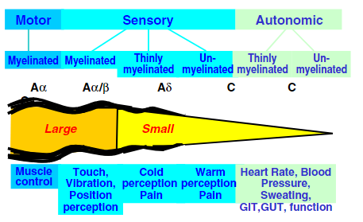
A simplified view of the peripheral nervous system
Vinik AI, Mehrabyan A. Diabetic neuropathies. Med Clin North Am. 2004;88(4):947-999, xi.

Slide 33
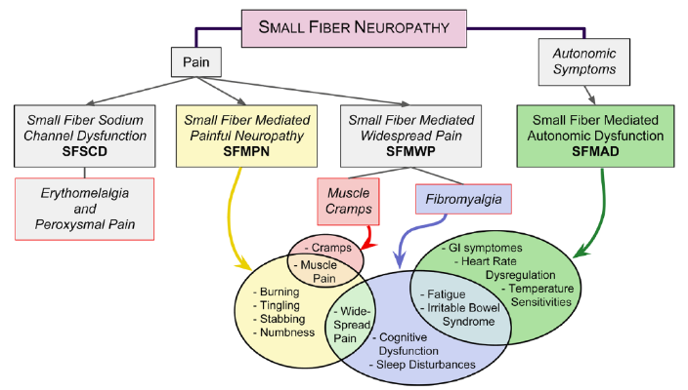
Small fiber neuropathy classification and associated symptoms (Levine 2018)
Localized neuropathic syndromes with tingling, burning, numbness: SFM-PN
Widespread pain accompanied by cognitive dysfunction, sleep disturbance: SFM-WP
Dysautonomia: SMF-AD
Levine TD. Small Fiber Neuropathy: Disease Classification Beyond Pain and Burning. J Cent Nerv Syst Dis. 2018;10:1179573518771703.

Slide 34
Small fiber neuropathy in PASC
13 subjects with painful paresthesia and numbness 2 months after SARS-CoV-2 infection.
6 had small fiber neuropathy (SFN) by skin biopsy.
3 subjects had autonomic nervous system symptoms, of whom 2 had positive biopsy for SFN
9 patients with PASC, 15 controls
All PASC patients had muscle pain, autonomic symptoms and brain fog.
All PASC patients had reduced cerebral blood flow and increase in pulse with no change in blood pressure on tilt table (no changes in controls).
No controls and 78% of PASC subjects had small fiber neuropathy by skin biopsy.
Abrams RMC, Simpson DM, Navis A, Jette N, Zhou L, Shin SC. Small fiber neuropathy associated with SARS-CoV-2 infection. Muscle Nerve. 2022;65(4):440-443.
Novak P, Mukerji SS, Alabsi HS, et al. Multisystem Involvement in Post-Acute Sequelae of Coronavirus Disease 19. Ann Neurol. 2022;91(3):367-379.

Slide 35
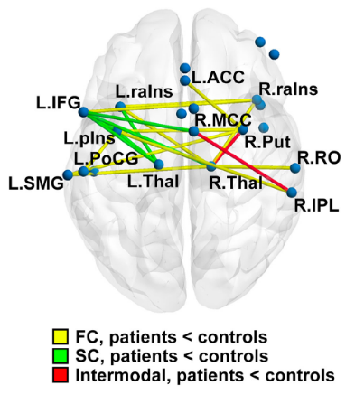
Reduced CNS connectivity in subjects with small fiber neuropathy
53 subjects with biopsy-confirmed small fiber neuropathy (SFN) compared with 53 age and sex matched controls.
On fMRI testing, the SFN patients exhibited a robust and global reduction of functional and structural connectivity, mainly across the limbic and somatosensory systems.
There was also reduction in structural connectivity in the cognition-integration areas.
Chao CC, Hsieh PC, Janice Lin CH, Huang SL, Hsieh ST, Chiang MC. Limbic Connectivity Underlies Pain Treatment Response in Small-Fiber Neuropathy. Ann Neurol. 2023;93(4):655-667.

Slide 36
Initial approach to suspected Post-COVID Syndrome
Make the diagnosis:
Did the symptoms begin after COVID19 infection?
Have they persisted for 3 months or more?
Are there alternate diagnoses?
Communicate the diagnosis:
Information and validation are key.
Offer practical help:
Letters to employers, FMLA
Referrals to social work, counseling
Prioritize symptoms
What 3 symptoms bother you the most?
Symptom-specific management

Slide 37
Characteristics of a contested illness
Experiences of Long COVID patients
Provider disbelief, lack of understanding, and attribution of symptoms to other causes impeded access to care
Provider listening and validating symptoms facilitated access to care
Confusion communicating overlapping symptoms to providers
Frustration with normal test results
Feeling there is nothing that can be done
Appreciation of providers who are open to new treatment options
Concern about long-term impact
Status as a legitimate illness is controversial
Etiology is ambiguous
Symptoms may be attributed to other diagnoses and comorbid conditions
Treatment regimens unclear
Legal, medical and cultural classification is disputed
Swoboda DA. The social construction of contested illness legitimacy: a grounded theory analysis. Qual Res Psychol. 2006;3(3):233-251.
MacEwan SR, Rahurkar S, Tarver W, Forward C, Eramo J, Gaughan A, Rush LJ, McConnell EM, Schamess A, McAlearney AS. 2023. “Patient Experiences Navigating Care Coordination for Long COVID: Lessons for Healthcare Systems and Providers.” SeroNet Investigators Meeting, Bethesda, MD.

Slide 38
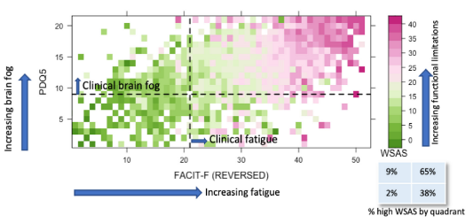
Functional impairment due to fatigue, depression and brain fog in 3774 treatment-seeking patients with PCC
Functional Assessment of Chronic Illness Therapy – Fatigue (FACIT-F)
Brain fog: Perceived Deficits Questionnaire (PDQ-5)
Depression: PHQ-8
Work and Social Adjustment Scale (WCAS)
Ability to work
Home management
Social / private leisure activities
Close relationships
Walker S, Goodfellow H, Pookarnjanamorakot P, et al. Impact of fatigue as the primary determinant of functional limitations among patients with post-COVID-19 syndrome: a cross-sectional observational study. BMJ Open. 2023;13(6):e069217.

Slide 39
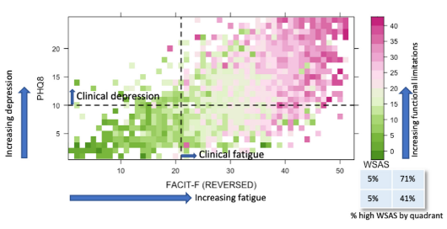
Functional impairment due to fatigue, depression and brain fog in 3774 treatment-seeking patients with PCC
Functional Assessment of Chronic Illness Therapy – Fatigue (FACIT-F)
Brain fog: Perceived Deficits Questionnaire (PDQ-5)
Depression: PHQ-8
Work and Social Adjustment Scale (WCAS)
Ability to work
Home management
Social / private leisure activities
Close relationships
Walker S, Goodfellow H, Pookarnjanamorakot P, et al. Impact of fatigue as the primary determinant of functional limitations among patients with post-COVID-19 syndrome: a cross-sectional observational study. BMJ Open. 2023;13(6):e069217.

Slide 40
Biographical disruptions in COVID Long-Haulers
In-depth interviews with 20 working adults in the U.S. who identified as COVID Long-Haulers
Illness experience is misaligned with sense of self and age-based expectations
Challenge to identity and social roles
Reconciling illness and identity in the context of uncertain prognosis
Spence NJ, Russell D, Bouldin ED, Tumminello CM, Schwartz T. Getting back to normal? Identity and role disruptions among adults with Long COVID. Sociol Health Illn. Published online March 7, 2023. doi:10.1111/1467-9566.13628

Slide 41
Communication: sometimes better than pills
Diagnosis
Validation is therapeutic for many patients
Diagnosis allows patients to communicate with others (workplace, family, friends)
Diagnosis permits chronic disease education and self-management
Prognosis
Not bad for patients with duration < 12 months.
Reason for optimism for recently infected.
Allows planning for possible short-term or long-term disability, and necessary accommodations.

Slide 42
Pacing
Definition: an approach where patients are encouraged to be as active as possible within the limits imposed by the illness. In practice, pacing requires the individual to determine a level at which they can function, but which does not lead to a marked increase in fatigue and other symptoms (Goudsmit, et al).
Cognitive rest
Work accommodations
Rebalancing of family responsibilities
Goudsmit EM, Nijs J, Jason LA, Wallman KE. Pacing as a strategy to improve energy management in myalgic encephalomyelitis/chronic fatigue syndrome: a consensus document. Disabil Rehabil. 2012;34(13):1140-1147.

Slide 43
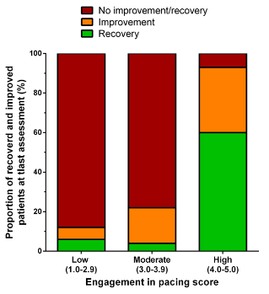
Efficacy of Pacing in Long COVID
86 patients at Angers University Hospital who met the WHO definition for Post-COVID Condition.
Most common symptoms at initial visit were fatigue, myalgia and cognitive impairment.
All were educated on pacing strategies.
Adherence assessed by Engagement in Pacing Scale.
Recovery: return to work.
Improvement: reduction in umber and severity of symptoms.
Ghali A, Lacombe V, Ravaiau C, et al. The relevance of pacing strategies in managing symptoms of post-COVID-19 syndrome. J Transl Med. 2023;21(1):375.

Slide 44
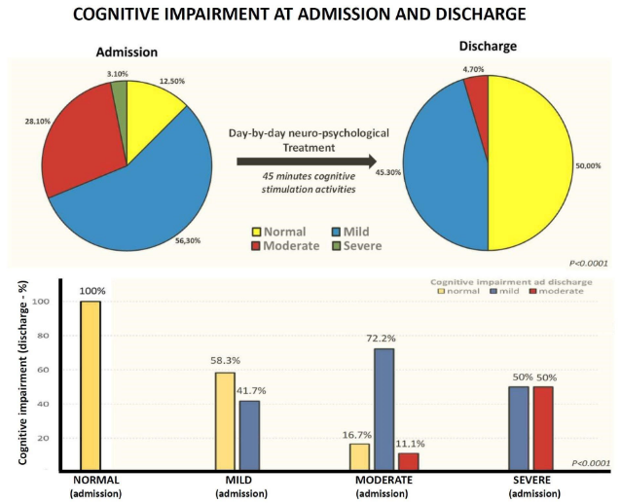
Cognitive rehabilitation and outcomes in Long COVID cognitive impairment
64 consecutive patients with PASC treated on rehab ward with individualized cognitive rehabilitation.
A significant improvement in the MoCA score was found (20.4 ± 5 vs. 24.7 ± 3.7; p < 0.0001) with improvement in attention task (p = 0.014), abstract reasoning (p = 0.003), language repetition (p = 0.002), memory recall (p < 0.0001), orientation (p < 0.0001), and visuospatial abilities (p < 0.0001).
Rabaiotti P, Ciracì C, Donelli D, et al. Effects of Multidisciplinary Rehabilitation Enhanced with Neuropsychological Treatment on Post-Acute SARS-CoV-2 Cognitive Impairment (Brain Fog): An Observational Study. Brain Sci. 2023;13(5). doi:10.3390/brainsci13050791

Slide 45
Management of PASC Neurologic Symptoms
Neurocognitive fatigue (“brain fog”)
Cognitive rest
Work accommodations
Cognitive rehabilitation
Pharmacotherapy: amantadine, modafinil, donepezil, LDN
Neuromuscular fatigue / myalgias
Symptom-titrated physical therapy
Pharmacotherapy: gabapentinoids, TCAs
Headache
CBT / mindfulness training
Amitriptyline
CGRP inhibitors
Adjustment disorder
Education, reassurance
CBT
Depression and anxiety
Pharmacotherapy (favor bupropion)
Avoid SNRI’s if dysautonomia
Poor sleep
CBT
Melatonin
Amitriptyline / other agents
Anosmia (and maybe brain fog…)
Stellate ganglion block

Slide 46
Preliminary data supporting the benefit of amantadine
At least 10% improvement at 3 months compared with baseline | Amantadine – (n=61) | Amantadine + (n=14) | Relative risk of improvement with amantadine
Fatigue | 36% | 75% | 2.075 (1.3, 3.22)
Sleep disturbance | 36% | 63% | pending
Anxiety | 33% | 56% | pending
Depression | 32% | 56% | pending
Database of 75 patients from OSUMC PASC Clinic with diagnosis by clinician of Post-COVID neurologic symptoms
PROMIS29 inventory completed at clinic enrollment and 3 months later
14 treated with amantadine
Amantadine-treated patients had greater improvement in neuropsychological symptoms
Limits: non-randomized retrospective cohort, relatively small sample, PROMIS29 not ideal for measuring cognitive symptoms

Slide 47
Preliminary data supporting the benefit of amantadine
Patient report | Number | Percent
Effective | 17 | 44
Partially effective | 5 | 13
Ineffective | 13 | 34
Not tolerated | 3 | 8
Total | 38
Manual chart review of patients treated with amantadine for cognitive symptoms
Patient report on follow up visit coded as above
Limits: clinical data, not blinded, not rigorously collected
Presented to give a rough idea of how many patients perceive improvement with amantadine

Slide 48
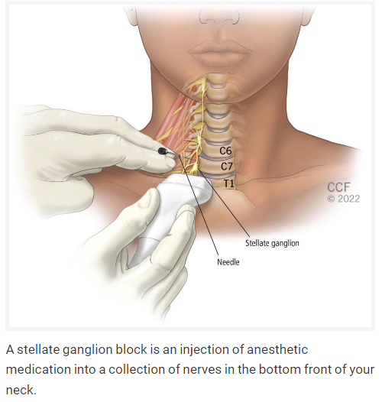
Stellate ganglion block
Complex regional pain syndrome of the head and upper limbs
Postherpetic neuralgia
Hyperhidrosis
Scleroderma
Orofacial pain
Phantom limb (upper extremity)
Atypical chest pain
Cluster headache
Post-traumatic stress disorder
Meniere syndrome
Stellate Ganglion Block. Cleveland Clinic. Accessed July 9, 2023. https://my.clevelandclinic.org/health/treatments/17507-stellate-ganglion-block

Slide 49
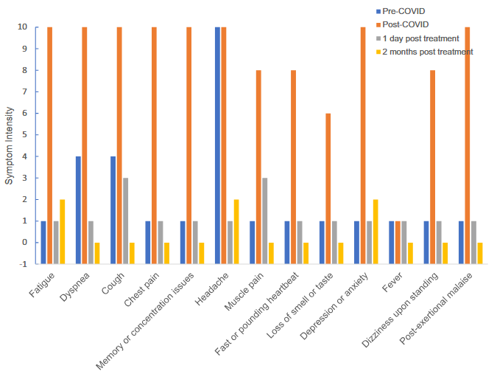
Stellate ganglion block
Data from one of three reported patients with Long COVID who had stellate ganglion block for anosmia.
Does sympathetic overactivity play a role in Long COVID symptoms…?
Cerebral blood flow
Ongoing CNS inflammation
Dysfunctional breathing
Elevated heart rate
Liu LD, Duricka DL. Stellate ganglion block reduces symptoms of Long COVID: A case series. J Neuroimmunol. 2022;362:577784.

Slide 50
Takeaway points – epidemiology and diagnosis
The symptoms seen in PASC are also seen at a “background level” in the non-infected population.
The WHO and CDC definitions are probably over-inclusive.
It is important to rule out other causes of symptoms in persons who do not fit the expected presentation / time course for PASC, particularly older and high-risk patients.
Investigators from the RECOVER Initiative have proposed a new 12-point scoring system for diagnosing PASC.

Slide 51
Takeaway points – central nervous system
PASC is associated with microglial cell activation (gliosis) particularly in the brainstem and hippocampus, in areas related to emotional regulation, learning and memory.
This could be due to multiple factors, including
Persistent systemic inflammatory state with mediators crossing BBB (especially CCL-11)
Altered gut-brain signaling
Toxic products of tryptophan metabolism
Mitochondrial damage / failure of repair
Vasculopathy
Extent and localization of gliosis roughly correlate with degree and nature of cognitive impairment.

Slide 52
Takeaway points – brain fog
There is overlap, but not perfect correspondence, between subjective brain fog and objective cognitive deficits
Not all patients with brain fog show cognitive impairment on testing
There is a sizeable population of patients who have measurable cognitive impairment with no symptoms following SARS-CoV-2 infection.
Brain fog is probably multifactorial, with fatigue, mood symptoms, sleep and behavioral factors playing a role along with brain inflammation.

Slide 53
Takeaway points – peripheral nervous system
There is marked overlap between peripheral neurologic symptoms in PASC (pain, dysautonomia) and the symptoms of small fiber neuropathy.
Small fiber neuropathy has been documented in a high proportion of PASC patients in small studies.

Slide 54
Takeaway points – management
Diagnosis, validation and patient education are important.
Cognitive rehabilitation is a first-line treatment.
Pacing has been shown effective for fatigue and brain fog in at least one controlled trial.
The prognosis for eventual recovery is reasonably good, especially in patients with onset of Long COVID < 1 year
Repurposed medicines in clinical use:
Guanfacine/ NAC
Amantadine
Modafinil and Armodafinil
Low dose naltrexone
Procedures: stellate ganglion block

